Slide 1
Maze Game Gameboy.CN
Jiachen Ma
Kuntao Zhu
Weihua Liu

Slide 2
Initial idea
We want to create a 2D game which can bring people happiness as well as give them something valuable
We decided to made it for young's
We choose maze game.
Detail: Using gravity accelerometer, gyroscope. Different difficulty will correspond to different stage.

Slide 3
Customer segment
Preschool children and players under 12.
Children who don’t have enough time on games

Slide 4
Value proposition
The mobile app will develop player’s intelligence, patience, ambitions, and ability of time management.
This game will let children enjoy and learn new things without time consuming.

Slide 5
Related apps & details
Related apps: Naught, Maze Master, all general maze games are related to our maze game.
Easy to start: Difficulties will slowly grow in each stage. User will not feel frustrated at first, but also be able to challenge high difficulty puzzles later.
Easy control: by using gravity accelerometer instead of key board.
Time limited: Each level will have a time limit.

Slide 6
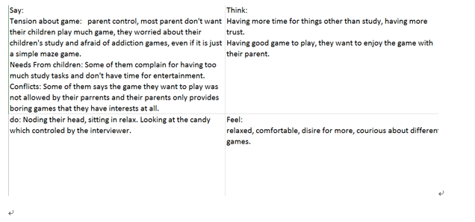
Empathy Map

Slide 7
Point of view
User: Preschool children
Needs: Children want more time on entertainments like games or sports.
Surprise: We were surprised to discover that children do not have enough time/ access to games they like.
Insight: It would better consume children less time on games as there is time limitation. Games have to work in efficient way and teach children some thing Patience etc.

Slide 8
Point of view
Contradictions: The game made for adult are not suitable for young. Most games are time killers and parents hate them.
Tensions: Most games are time consuming, will distract children from their studies.

Slide 9

User journey diagram
 | Title:
 | Preschool student
 | Description of life:
 | Study, sport, game
Goal: | Experience:
Good grade, enough game. | Cell phone, laptop
Problem:
Too much homework, too few free time. | Activity/ interests:
 | Basketball, pizza, puzzle game.

